Slide 1


Components - In Depth
Prop Types, Slots, Dynamic Components
SoftUni Team
Technical Trainers
Software University
http://softuni.bg

Slide 2
Table of Contents
Prop Types
Slots
Named Slots
Scoped Slots
The Event Bus
Dynamic Components

Slide 3
Have a Question?
sli.do #vue-js

Slide 4

Prop Types
List of Types, Default Values, Validator

Slide 5
Validating Props
So far, we've only seen props listed as an array of strings
Usually though, you'll want every prop to be a specific type of value
Prop Types are a really simple way to catch a lot of potential errors
They let you describe what types of values your component is expecting for each prop

Slide 6
Type Checking Props
To type check your props use an object instead of an array
// Parent Component
<app-container :quotesCount="11" :username="Peter">
</app-container>
// Child Component
props: {
username: String,
quotesCount: Number
}

Slide 7
List of Prop Types
The valid types you can use are:
String, Number, Boolean, Array,
Object, Date, Function, Symbol
When a type mismatches, VueJS alerts (in development mode) in the console with a warning
This is NOT a compile time error

Slide 8
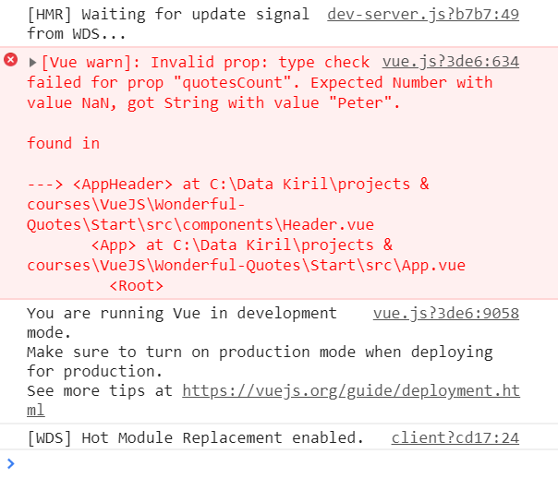
Props Type Error Example
Pass a String instead of a Number

Slide 9
Multiple Value Types
A prop can have multiple value types
Not recommended in most cases
Keep prop types as strict as possible!
props: {
counter: {
type: [ String, Number ]
}
}

Slide 10
Mandatory Prop
Along with adding types to your props, you can also specify if the prop is required or not
props: {
birthday: {
type: Date,
required: true
}
}

Slide 11
Default Value
As a rule, if a prop isn't required, it should have a default value
Forgeting to pass a prop will assign the default
props: {
birthday: {
type: Date,
default: new Date('July 10, 1856')
}
}

Slide 12
Validators
Verify array types using a validator
Returns true/false based on the custom validation
quotes: {
type: Array,
validator: (arr) => {
return arr.every(q => typeof q === 'string')
}
}
Validates an array of strings

Slide 13

Slots
Passing Content, Named & Scoped Slots

Slide 14
Slots - Definition
Passing data with props can be harsh when:
The properties are a lot
You need to pass HTML between components
Slots serve as distribution outlets for content
Inspired by Web Components
Similar to React's children prop and Angular's <ng-content>

Slide 15
Passing Content with Slots
Pass HTML between the opening and closing tag
Data is stored inside the parent component
<app-profile>
<h1>This is the profile page</h1>
<p>Username: {{ username }}</p>
<p>Email: {{ email }}</p>
<p>Age: {{ age }}</p>
</app-profile>

Slide 16
Rendering the Slot
To render the HTML passed from the parent simply use the <slot> tag
<template>
<div class="row">
<slot></slot>
</div>
</template>

Slide 17

Slot Compilation
The slot does NOT have access to the parent's data
It has the same "scope" as the rest of the template
As a rule remember:
Everything in the parent template is compiled in parent scope
Everything in the child template is compiled in the child scope
<slot> {{ username }} </slot>

Slide 18
Named Slots
There are times when it's useful to have multiple slots
For example with a base layout – header, main, footer
Slots can be named using an attribute
<app-profile>
<h1>This is the profile page</h1>
<p slot="username">Username: {{ username }}</p>
<p slot="email">Email: {{ email }}</p>
<p slot="age">Age: {{ age }}</p>
</app-profile>

Slide 19
Named Slots
Render only some of the named slots (or all of them)
<div class="row">
<template>
<slot name="username"></slot>
</template>
<template>
<slot name="email"></slot>
</template>
</div>

Slide 20
Default Slot
Unnamed slots are also rendered
Everything without the "slot" attribute is rendered as a default
// Parent
<h1>This is the profile page</h1>
// Child
<template>
<slot></slot>
</template>

Slide 21
Scoped Slots
Sometimes, it's useful for slot content to have access to data only available in the parent component
Make content available in the child component
Use v-bind on the slot itself
Also called slot props

Slide 22
Scoped Slots Example
// The Child
<span>
<slot v-bind:user="user">
{{ user.lastName }}
</slot>
</span>
// The Parent
<current-user>
{{ user.firstName }}
</current-user>

Slide 23
Props vs Slots
Slots
Good when dealing with a lot of variables and HTML
Pass other components
Component becomes more readable and less confusing
Props
Good only for passing fewer data
Cannot pass other components
Component can become hectic

Slide 24

The Event Bus
Communication - Siblings

Slide 25
The Event Bus
Sometimes you need a quick and easy solution to pass data between components
Emitting Events can become complex between non parent-child relationships
The Event Bus is a centralized solution
Emit an event in one component
Listen to that event in any other component

Slide 26
Initialize Event Bus
Export it inside the main.js file
export const eventBus = new Vue({
methods: {
increase(value) {
this.$emit('onIncrease', value + 1);
}
}
});

Slide 27
Call the Method
Call the event emitting method inside some child component
// Nested Child Component
methods: {
increaseHandler() {
eventBus.increase(this.counter);
}
}
Import the bus inside the file

Slide 28
Listening to Events
The root parent component that connects the siblings listens to that event
After that it passes down the prop to the other child
created() {
eventBus.$on('onIncrease', (data) => {
this.counter = data;
});
}
Lifecycle hook

Slide 29

Dynamic Components
Switch Between Components

Slide 30
Dynamic Components
Switching between components dynamically is possible and useful in some cases like:
Loading different components by clicking on buttons
Rendering components conditionally without using v-if
Placed inside the <component> tag
Container for dynamic components

Slide 31
The Component Tag
The tag takes a string (or component definition) :is prop
<button @click="selectedComponent = 'appQuote'">Quote</button>
<button @click="selectedComponent = 'appAuthor'">Author</button>
<button @click="selectedComponent = 'appNew'">New</button>
<component :is="selectedComponent">
<h1>Default Title</h1>
</component>
The component selector

Slide 32
Reactive Switch
Reactively switch between components with computed properties
dynamicComponent() {
if(this.isLoaded) {
return 'component-special';
} else {
return 'component-default';
}
}

Slide 33
Maintaining State
Components are destroyed when switched
They are re-created and added again inside the tag
Use the <keep-alive> component to maintain state
<keep-alive>
<component :is="selectedComponent">
<h1>Default Title</h1>
</component>
</keep-alive>

Slide 34

Summary
Props can be validated using PropTypes
Default, Required, Validator
Slots serve as distribution outlets for content
The Event Bus is a centralized management system
Dynamic Components
Switch easily between components
…
…
…

Slide 35
https://softuni.bg/trainings/2430/vuejs-fundamentals-july-2019

Slide 36












SoftUni Diamond Partners

Slide 37




SoftUni Organizational Partners

Slide 38





Trainings @ Software University (SoftUni)
Software University – High-Quality Education, Profession and Job for Software Developers
softuni.bg
Software University Foundation
http://softuni.foundation/
Software University @ Facebook
facebook.com/SoftwareUniversity
Software University Forums
forum.softuni.bg

